Slide 1





MOCO HIGHSCHOOLS
RAQUEL OLIVAR
DATA 110

Slide 2


INTRODUCTION
MONTGOMERY COUNTY HIGHSHOOLS
(2018 - 2019)
This dataset includes:
Locations
Magnet program & ranking
Allocated budget per school
Teacher population
Student demographic and performance

Slide 3
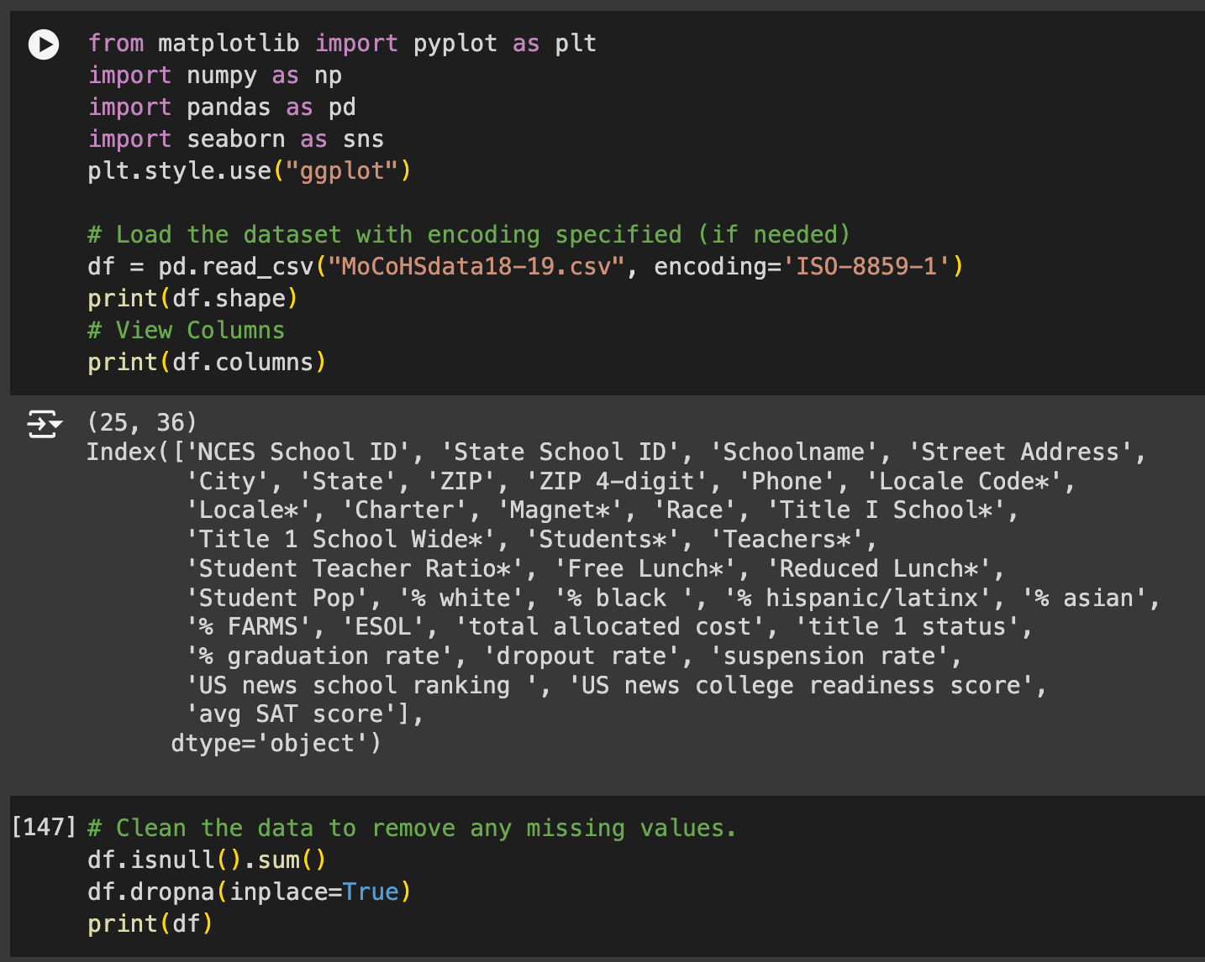

SIZE OF THE DATA
(25, 36)
COLUMN NAMES
CLEANING THE DATA FOR ALL NULL VALUES

Slide 4


UNDERSTAND THE DATA
POPULATION SIZE
STUDENT DEMOGRAPIC
AVERAGE SAT SCORES

Slide 5
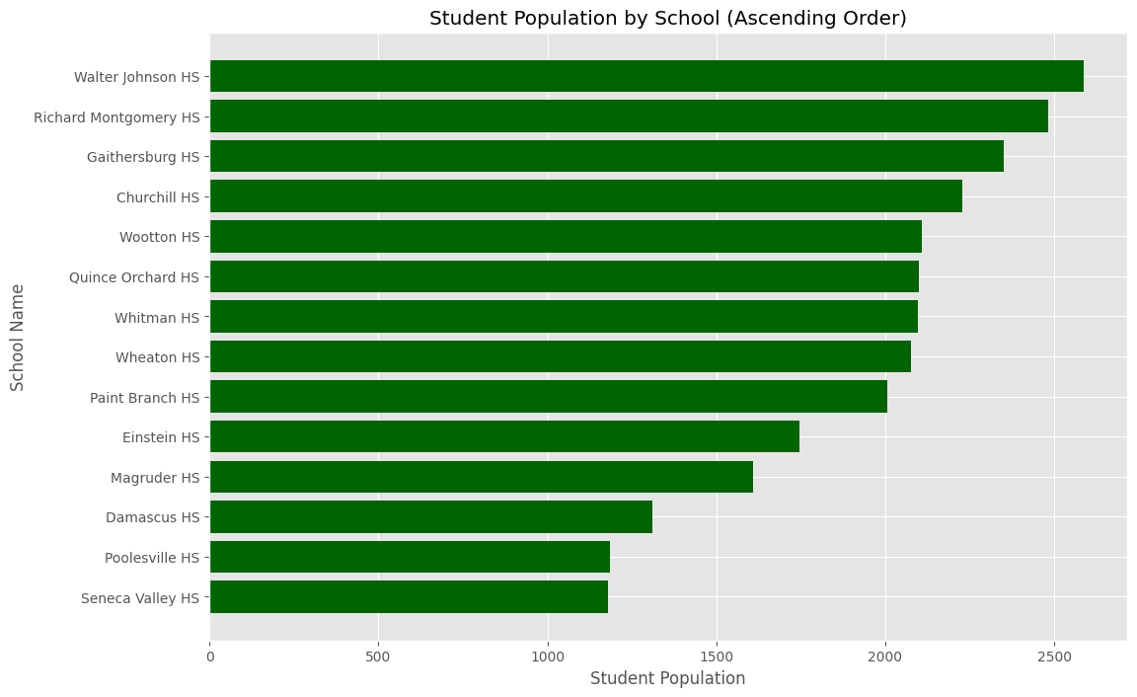
VISUAL #1
I choose to use a bar graph for student population by school graph to have a clear visual comparison of the number of students enrolled at each school in the dataset.
The student population by school as a bar graph provides a clear visual comparison of the number of students enrolled at each school in the dataset.

Slide 6
VISUAL #1
Student Population: The graph shows variation in student populations across schools, indicating that some schools serve a significantly larger or smaller student body compared to others. Larger schools may require more resources, support staff, and infrastructure to meet student needs effectively.

Slide 7

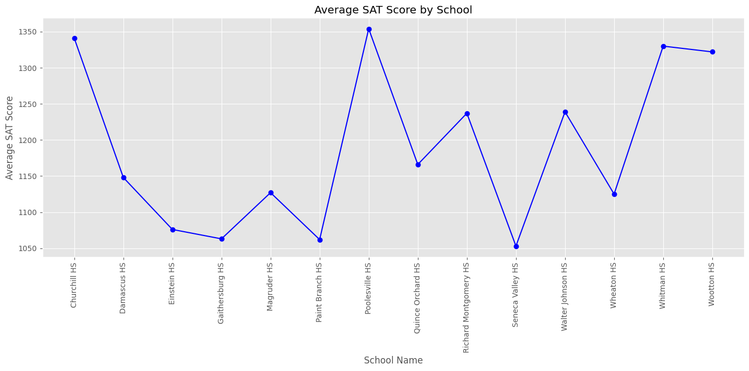
VISUAL #2
This line graph shows the average SAT scores by school, which provides a straightforward look at academic performance across different schools. This type of graph can help highlight any schools that stand out in SAT performance. The line graph provides a clear, sequential comparison of SAT performance by school, helping to highlight patterns, outliers, and areas for potential support.

Slide 8
VISUAL #2
Analysis of Average SAT Scores
The graph highlights how each school performs relative to others on the SAT. Schools with higher average scores may be serving student populations with better access to resources, advanced coursework, or additional support programs for SAT preparation.

Slide 9
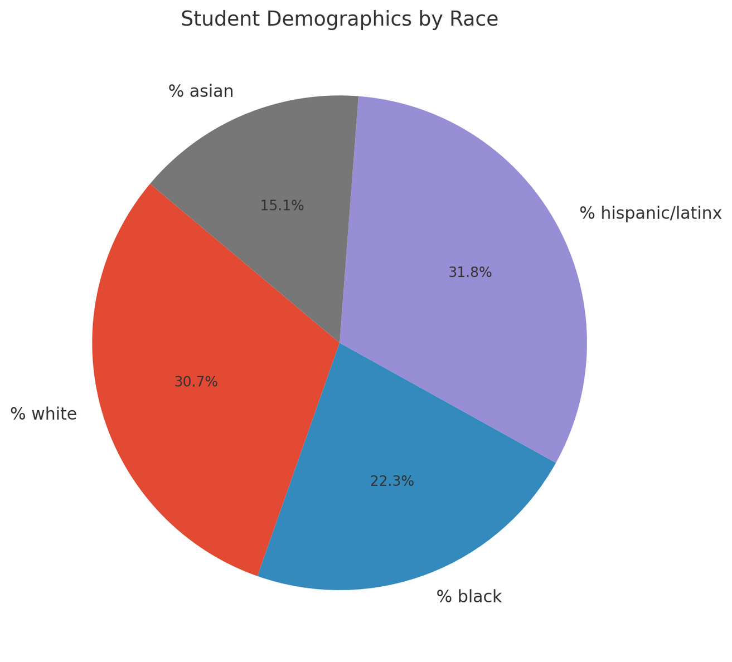
VISUAL #3
This pie chart displays the student demographics by race across all schools.
Each slice represents the percentage of the total student population for each racial group. A pie chart allows for a clear snapshot of Diversity. By representing each group as a portion of 100%, the pie chart makes it easy to see the diversity within the student population, highlighting the balance (or imbalance) among racial groups.

Slide 10
VISUAL #3
Overall Composition: The pie chart shows the percentage of each racial group in the overall student population. This can reveal the majority and minority groups within the student body, helping to assess the district's diversity and inclusivity.
In the case for montgomery county the top 4 races are Asian, Black, Hispanic and White.

Slide 11

OVERALL SUMMARY
These graphs collectively offer a comprehensive view of each school's demographics, performance metrics, and population size. Understanding these variations helps in equitable resource distribution and planning.

